Slide 1
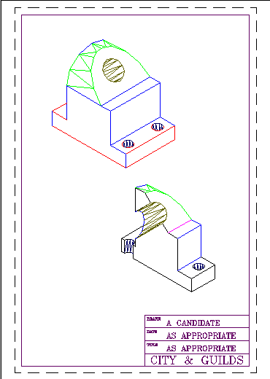
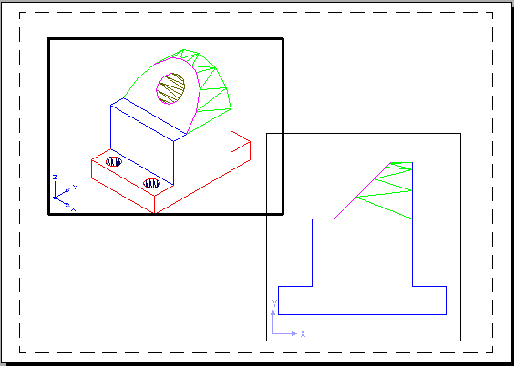
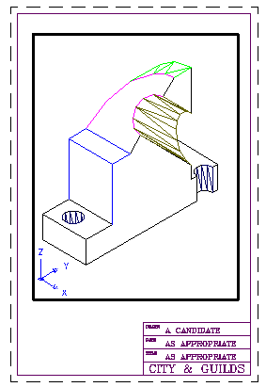
Paper space/Model space
Model space only so far
Paper space
  Same model, different presentations using paper space

Slide 2
Preparing to Print
Draw in Model Space
Prepare to print in Paper Space
  Start a new drawing using Paper Space as the template
  Insert Machine Support as a Block. Explode it.
  Click on the Blank A4 tab
  Create a new current layer called VP
  Make the left viewport first
    View, Viewports, 1
      Move/Stretch the viewport (in Paper Space)
      zoom/pan (in Model Space)
  Make the other viewport

Slide 3
Paper vs Model
What is Paper Space?
  You are drawing on a piece of paper (can be set to any size)
  WYSIWYG
  You can have many (overlapping) viewports containing views of the object
Paper Space/Model Space
Toggle button on status line or type PS or MS
Paper Space | Model Space
Draw and edit commands affect the drawing sheet and viewports. Draw the border in paper space | Draw and edit command affect the model
Zoom will affect the whole sheet | Zoom will only affect the current viewport
Paper space icon (triangular) shown in bottom left hand corner | Ordinary X-Y axis icon shown in bottom left hand corner

Slide 4
Tidying up in Paper Space
Viewport border lines
  Banish by freezing the layer called VP
Lose the UCS icon
  View, Display, UCS Icon, Off in each viewport
Viewing with hidden line removal
  View, Hide in each viewport
Plotting with hidden line removal
  Type MVIEW then H then ON, then click on each viewport border

Slide 5
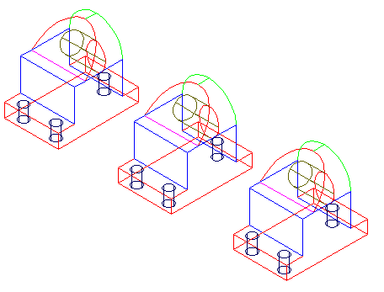
Sections
Model Tab
  Produce 2 copies of the support
    Create 2 new layers (called SECOND, THIRD)
    Put one copy on each layer
  Draw, Solids, Slice
    Pick three points on the slice plane (use the model on SECOND layer)
Layout 1 Tab
  Make VP current layer
  View, Viewports, 1 Viewport
  To lose copies of support
    Model Space
    Format, Layer, Current VP freeze.
      Current VP freeze layers 0 and THIRD.
Layer: SECOND
Layer: THIRD

Slide 6
Section Practice
Layout 2

